Slide 1
OOP Presentation
Hotel Reservation System
Syed Owais Ali-23053
Syed Fazal Ul Hasan Mohani-23024

Slide 2
Description:
Hotel Reservation System provides an easy to use room booking service to customers. Room management and other necessary hotel reservation features are also included. The system allows the hotel admin to view the current details about an occupied room, add amenities to a current booking, as well as post available rooms in the system as they are vacated. Meanwhile customers can view the information about a particular room (whether it is a single bed room, double bed room, a suite etc., amenities like free drinks or free breakfast) and book rooms online. The system is hence useful for both customers and admin to conveniently manage the hotel activities.

Slide 3
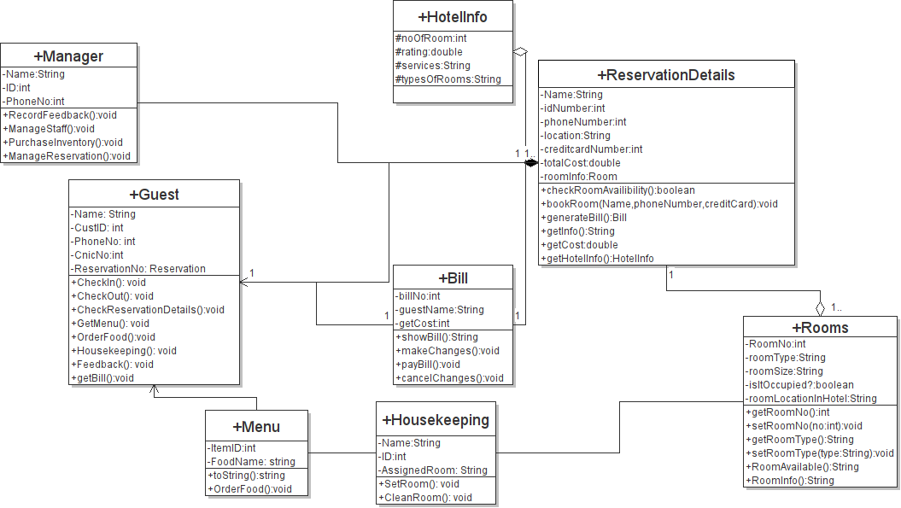
Old UML Diagram:

Slide 4
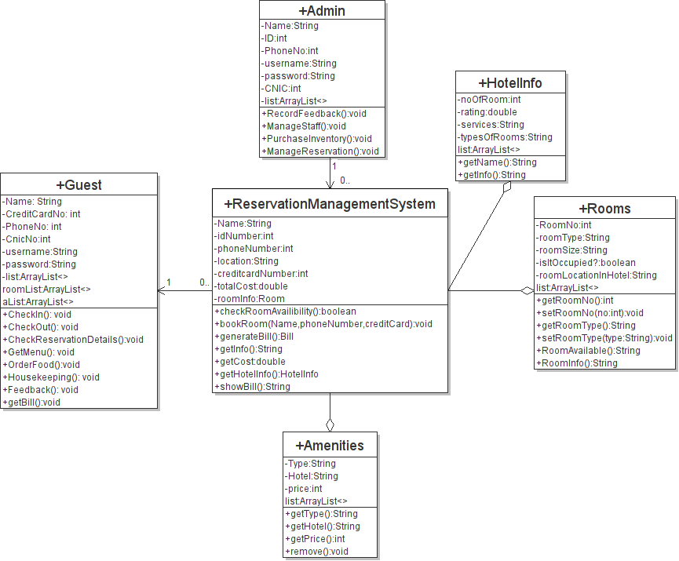
New UML Diagram

Slide 5
OOP Concepts
Encapsulation and Abstraction
Things that we learn in this course:
Catching and Handling Exceptions GUI Filing(Serialization and Deserialization) Regular Expressions

Slide 6
Demo

